Slide 1
ME 592X: Data Analytics and Machine Learning for Cyber-Physical Systems Applications
Lecture 11
Programming for Deep Learning
Aditya Balu
Spring 2019

Slide 2
Motivation
Exposure to Deep Learning Platforms
Efficient programming for DL
Tips for dealing with large data for DL
Alternative good sources:
https://cs230-stanford.github.io/project-code-examples.html

Slide 3
Deep Learning Training
Load Data
Define Model
Define learning strategy
Train
Load Test Data
Validate
Deploy

Slide 4
Challenges

Slide 5
Warmup Exercise (python)
Predict the output of these code snippets
class A(object):
"""docstring for A"""
def __init__(self, a=4, b=10, c=20):
self._a = a
self._b = b
self._c = c
@property
def a(self):
return self._a
@property
def b(self):
return self._b
@property
def c(self):
return self._c
def __repr__(self):
return "A Object"
if __name__ == '__main__':
a = A(4,6,8)
print(a)
print(a.a)
print(a.b)
print(a.c)
Source: https://github.com/adityabalu/PDL.git

Slide 6
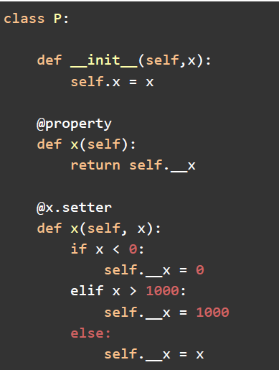
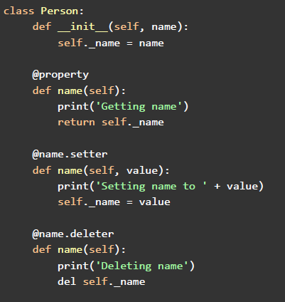
Property method (complete implementation)

Slide 7
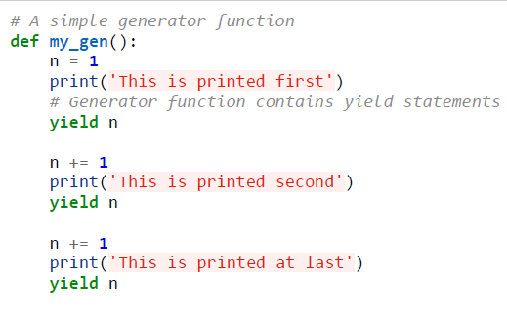
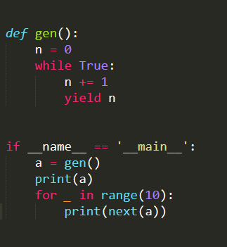
Generators (warmup)

Slide 8
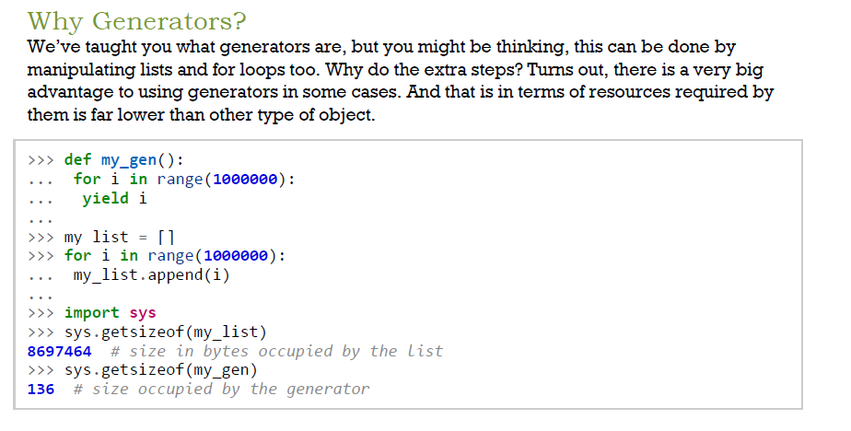

Slide 9
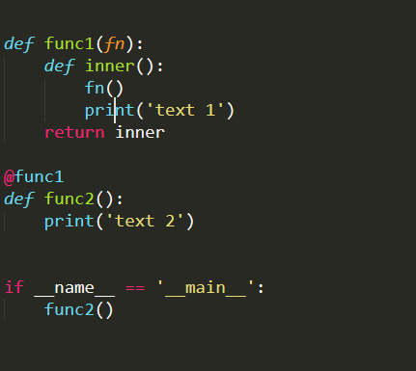
Decorators

Slide 10
Data Generators/Pipelines

Slide 11
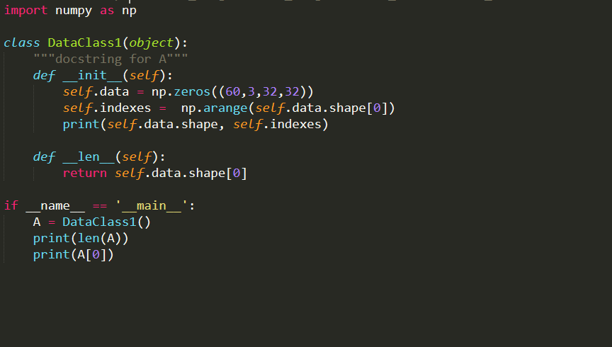
More Python fundamentals

Slide 12
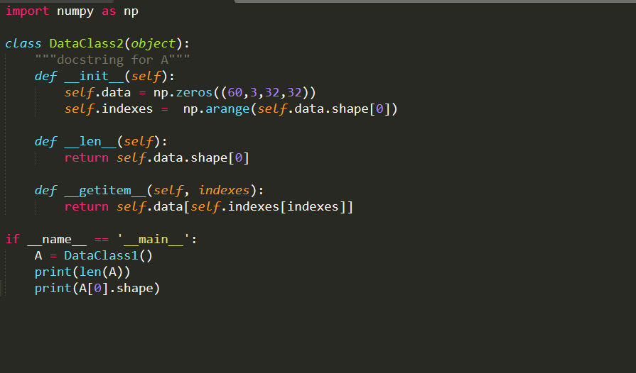
getitem method

Slide 13
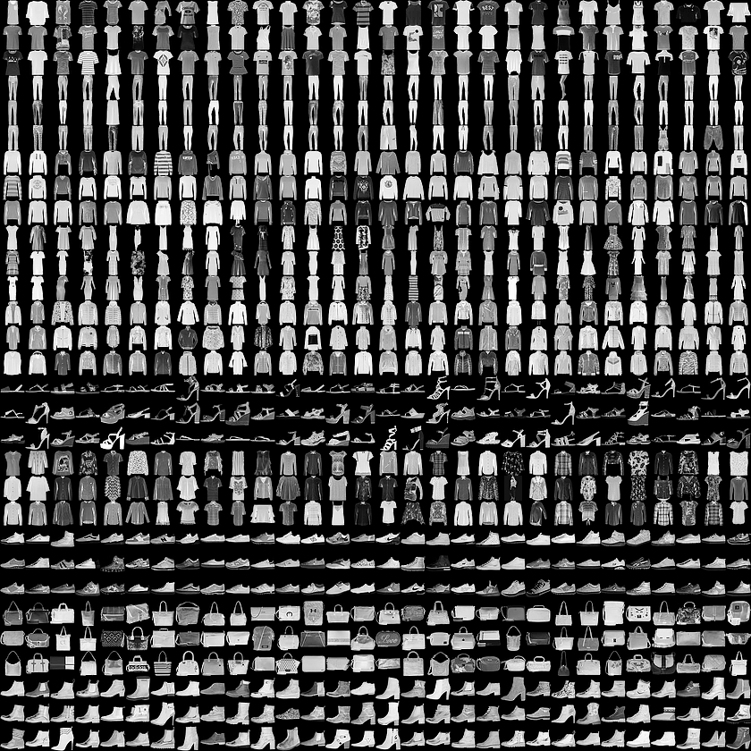
Naïve Implementation of a Data Loader (Fashion MNIST)
Fashion MNIST: https://github.com/zalandoresearch/fashion-mnist

Slide 14
Naïve Implementation
https://github.com/adityabalu/PDL/blob/master/DataProcessors/naive.py

Slide 15
Data Pipelines
Performing Preprocessing “on-the-fly”
PCA/ZCA Whitening
Normalization
Data Augmentation
One-hot encoding
Dealing with Big Data such as 14 billion images
Multi-processing

Slide 16
Data Pipelines in Keras
Simple Method:
Process all the data and feed to keras, it will do iterations etc.
Generator Method:
Advanced Method:
https://github.com/adityabalu/PDL/blob/master/DataProcessors/keras.py
Good Reading Sources:
https://blog.keras.io/building-powerful-image-classification-models-using-very-little-data.html
https://stanford.edu/~shervine/blog/keras-how-to-generate-data-on-the-fly
https://github.com/mdbloice/Augmentor

Slide 17
Data Pipelines in Tensorflow
Sources:
https://cs230-stanford.github.io/tensorflow-input-data.html

Slide 18
Data Pipelines in Pytorch

Slide 19
Learning Algorithms and Implementations

Slide 20
Naïve (with numpy)

Slide 21
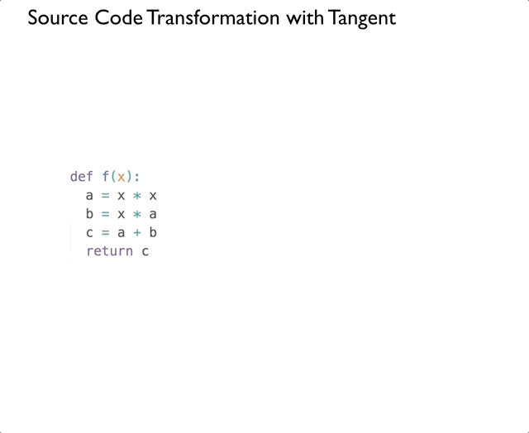
Back-propagation

Slide 22
Convolution, Max-pool and Dense Layer Backprop

Slide 23
ReLu, sigmoid, and linear Backprop

Slide 24
GPU implementation
Pytorch (embedding)

Slide 25
Keras

Slide 26
Tensorflow

Slide 27
Pytorch

Slide 28
Complete Pipeline for DL Training

Slide 29
Best Practices

Slide 30
Model Architecture
# of parameters
# of filters/kernels
Filter size/kernel size

Slide 31
Programming Constraints
GPU memory
CPU memory (RAM)

Slide 32
Benchmark Model Architectures

